Slide 1
Addressing multicomponent feed streams using diafiltration
Laurianne Lair, Jonathan A. Ouimet
4.15.24

Slide 2
Evaluating the relationship between conductivity and concentration
Is assuming a linear relationship between conductivity and concentration good enough?

Slide 3
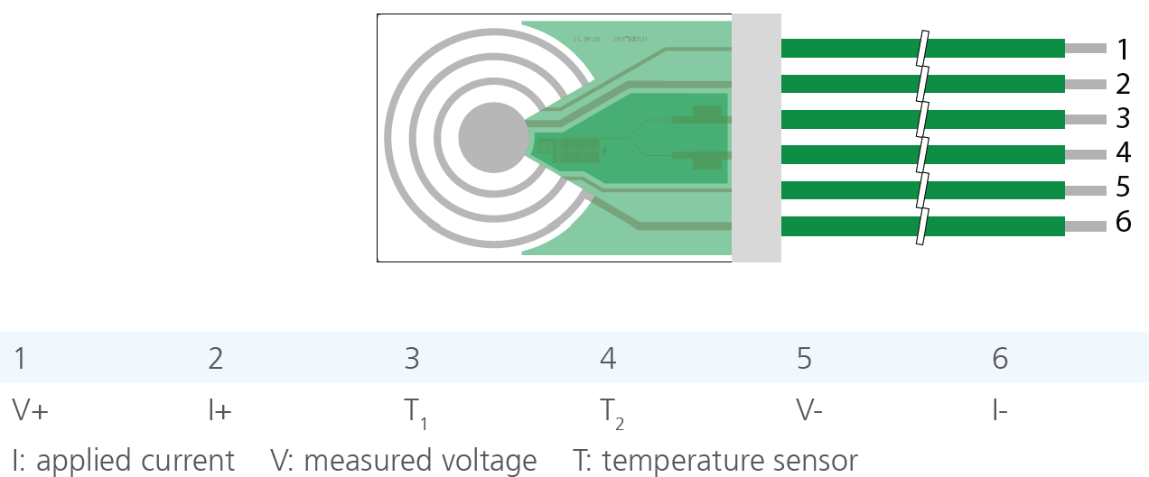

Conductivity probe basics
The diafiltration apparatus contains two conductivity probes, one in the retentate and one in the permeate.
This allows us to obtain continuous conductivity measurements, in which can be related to concentration.
Voltage is held constant.
Probe measures changes in electric current, which is related to the concentration of ions present in the solution.
$$Conductivity=\frac{I}{k_{cell}∗V}[=]\frac{μS}{cm}$$
The probes have a cell constant of 0.42 cm⁻¹

Slide 4
Conductivity measurements and predictions in single salt solutions
Concentration (mM)
-0.88
1.36
3.49
5.67
7.82
9.73
20.58
30.88
41.12
50.84
60.90
70.24
80.52
90.07
97.66
Concentration (mM) | Conductivity reading (uS/cm)
0 | 0.88
2 | 272.04
4 | 530.48
6 | 794.86
8 | 1055.1
10 | 1286.5
20 | 2601.9
30 | 3850.1
40 | 5090.6
50 | 6268.6
60 | 7488.8
70 | 8620.3
80 | 9866.1
90 | 11024
100 | 11944

Slide 5
Conductivity measurements and predictions in single salt solutions
This type of residual plot indicates a relationship other than linear between the experimental conductivities and those calculated from the regressed line.

Slide 6
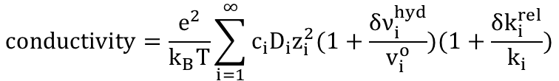
Conductivity measurements and predictions in single salt solutions
This equation works in dilute solutions:
For simplification, we assume that the parenthetical terms are negligible.
$$conductivity=\frac{e^{2}}{k_{B}T}\sum_{i=1}^{∞}{c_{i}D_{i}z_{i}^{2}(1+\frac{δν_{i}^{hyd}}{v_{i}^{o}})(1+\frac{δk_{i}^{rel}}{k_{i}})}$$
The predictions begin to break down at concentrations greater than 20mM.

Slide 7

Conductivity measurements and predictions in single salt solutions
$$conductivity=\frac{e^{2}}{k_{B}T}\sum_{i=1}^{∞}{c_{i}D_{i}z_{i}^{2}(1+\frac{δν_{i}^{hyd}}{v_{i}^{o}})(1+\frac{δk_{i}^{rel}}{k_{i}})}$$
This type of residual plot indicates a non-linear relationship between the experimental conductivities and those predicted from theory.

Slide 8
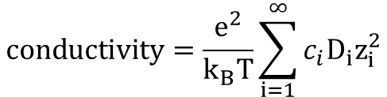
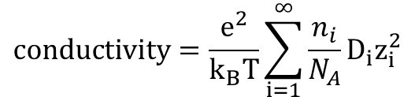
Concentration and conductivity relationship
Assume that we are working with dilute solutions.
$$conductivity=\frac{e^{2}}{k_{B}T}\sum_{i=1}^{∞}{\frac{n_{i}}{N_{A}}D_{i}z_{i}^{2}}$$
$$conductivity=\frac{e^{2}}{k_{B}T}\sum_{i=1}^{∞}{c_{i}D_{i}z_{i}^{2}}$$
https://pubs.acs.org/doi/epdf/10.1021/jp901916r

Slide 9
Conductivity measurements and predictions in multi salt solutions
Concentration of KCl and NdCl3 (mM) | Conductivity reading (uS/cm) | Concentration (mM)
0.00 | 0.52 | -0.933
2.56 | 1156.7 | 2.384
4.17 | 1833.8 | 4.326
6.25 | 2684 | 6.765
8.33 | 522.2 | 0.564
10.00 | 4181 | 11.059
20.00 | 8631.5 | 23.826
30.30 | 11513 | 32.091
40.00 | 14907 | 41.827
50.00 | 18309 | 51.586
60.24 | 21747 | 61.448
70.42 | 25064 | 70.963
80.00 | 28062 | 79.563
90.91 | 31598 | 89.706
100.00 | 34492 | 98.007
Using LaCl₃, CaCl₂, and NaCl for the multicomponent studies.
Measurements are currently being recorded by an undergraduate student.

Slide 10
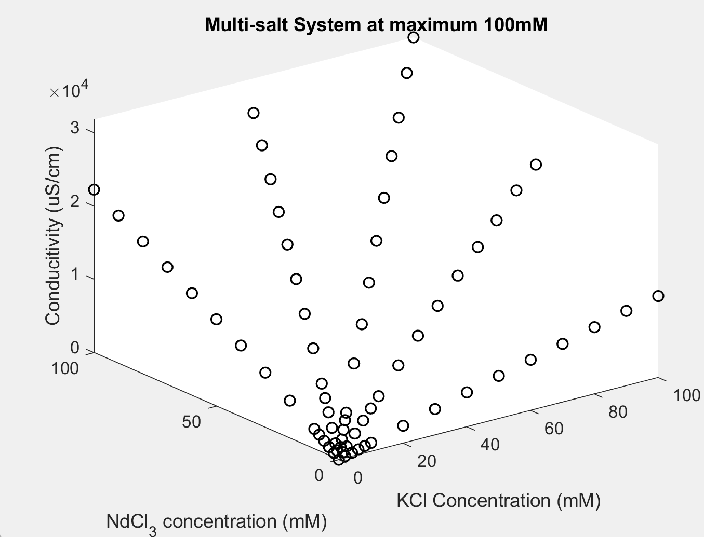
Conductivity measurements and predictions in multi salt solutions
This type of residual plot indicates a relationship other than linear between the experimental conductivities and those calculated from the regressed line.
Conductivity = 482.9+105.6*[KCl]+218.9*[NdCl₃]

Slide 11
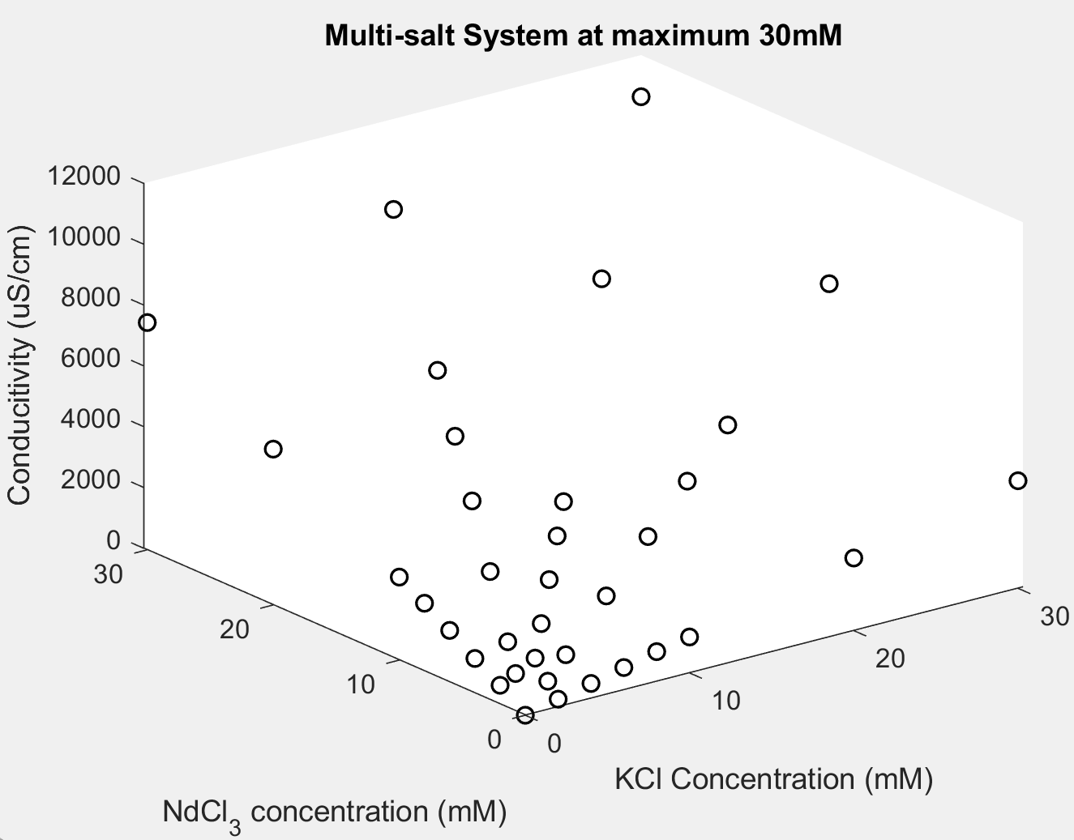
Conductivities in a multi-salt system are fit on MATLAB
Conductivity = 482.9+105.6*[KCl]+218.9*[NdCl₃]
Conductivity = 131.5+113.5*[KCl]+249*[NdCl₃]

Slide 12
Notes

